Slide 1
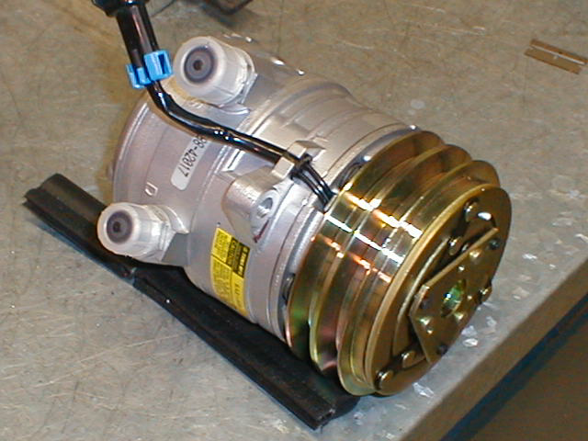
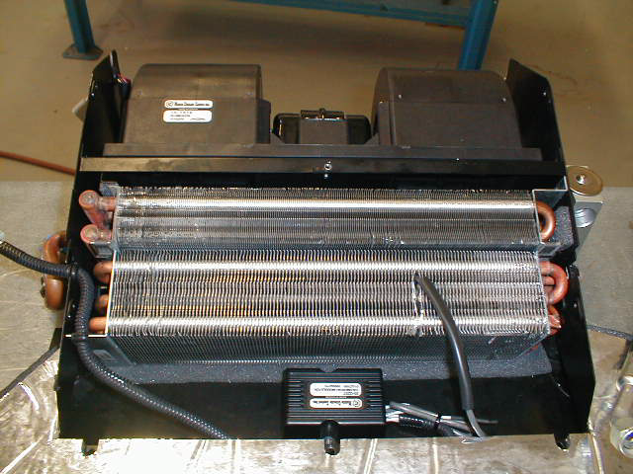
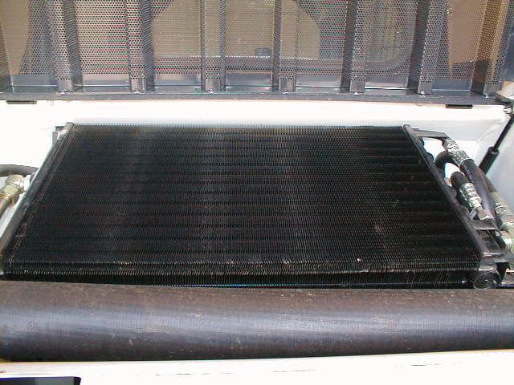
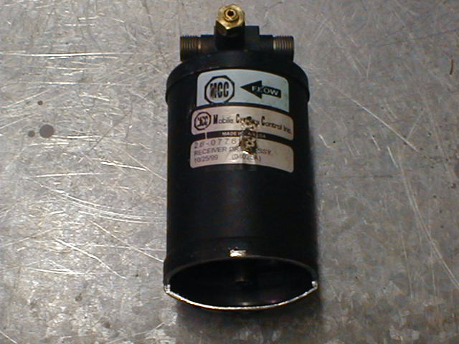
System Components
AC
System Oil
Complete System
Holds
150 To 170 CC
Pag Oil
New Pump
Comes with
150 to 170 CC
of oil.
60-80 CC
Pump
30 CC
30 CC
Evaporator
Condenser
Drier
30 CC
1CC=.0338 of OZ

Slide 2
Factors To Consider W/Oil
System Holds 150-170 cc’s of oil
Each component has 30 cc’s of oil
New Pump comes with 150-170 cc’s of oil
Adjust system oil based on
  Items Replaced, +30cc
  Items Cleaned, +30cc
  Items untouched, -30cc
  Addition of 1oz of dye, -30cc
  Broken hose after component, +30cc
  Broken hose after pump, measure pump & make up to = 60-80cc

